Slide 1
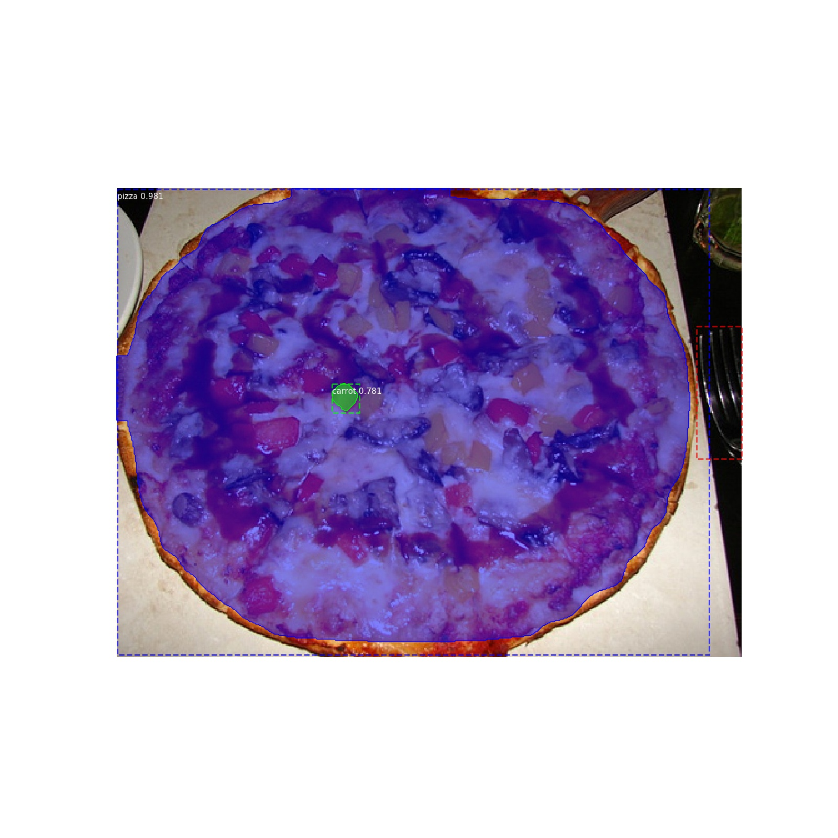
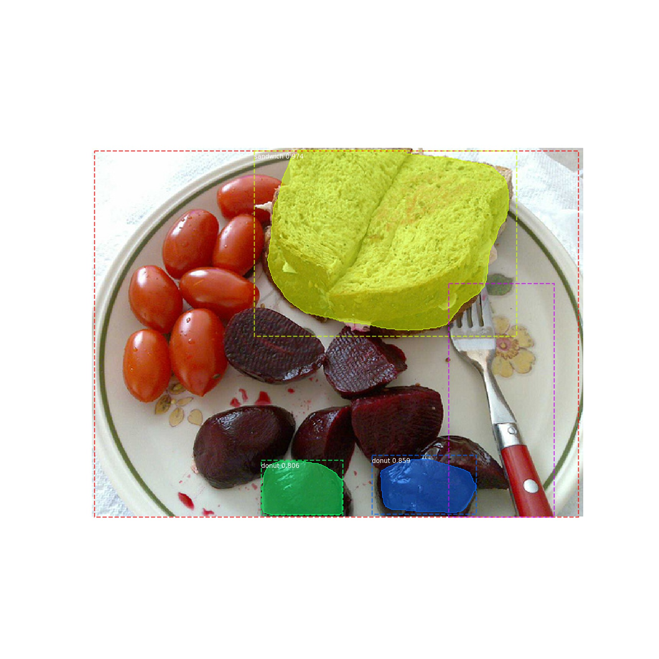
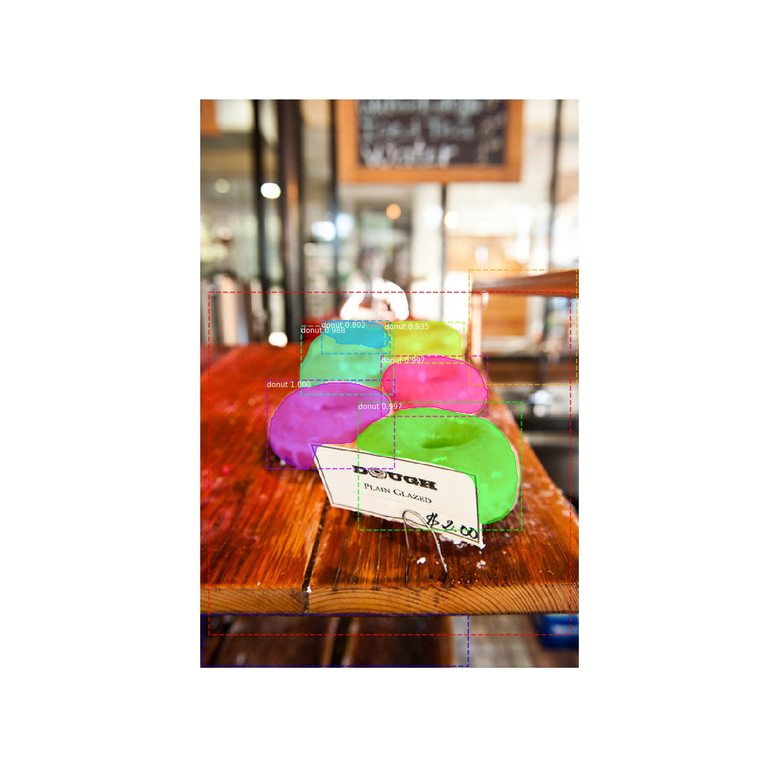
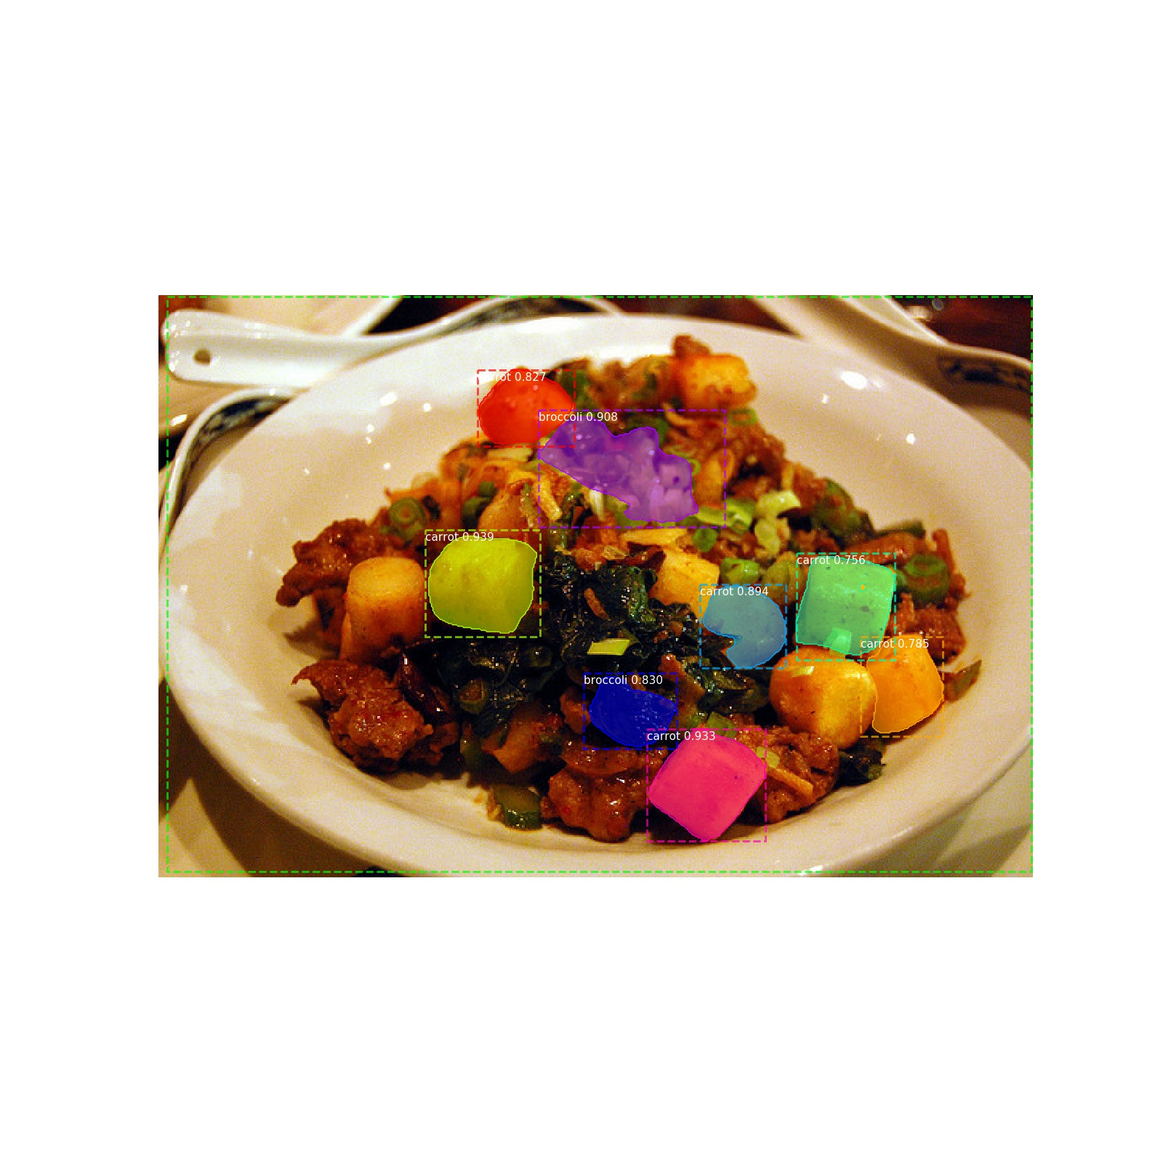
By Chintushig Ochirsukh
Foodify

Slide 2
What is Foodify?
Image segmentation model that recognizes certain types of food from a given image
We will be using Facebook`s Mask R-CNN algorithm

Slide 3
Why image classification?
Image classification is one of the core problems of Computer Vision
Despite its simplicity, has a large variety of practical applications
Not many applications submitted toward this area
Most of the Computer Vision problems boils down to image classification.

Slide 4
Related Works
R-CNN
Mask R-CNN
SSD (single shot MultiBox Detector by Google)
YOLO (You only look once)

Slide 5
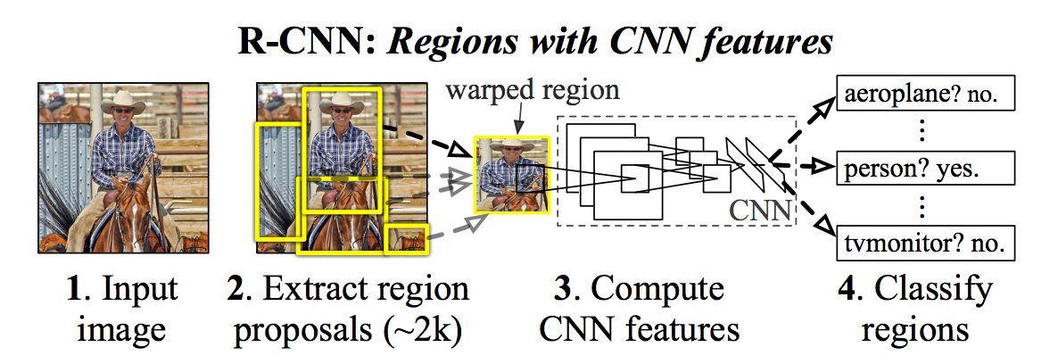
Convolutional neural network
Creates bounding boxes using Selective search
Grouping the boxes by passing it through CNN or AlexNet
Mask R-CNN is better and faster

Slide 6
My approach
The main framework will be in tensorflow and programming language will be python 3.0
Implementing the Mask R-CNN
model on my machine
Train and validate on a rented server because
I do not have access to a decent GPU

Slide 7
Validation
Both training and validation datasets are from COCO(cocodataset)

Slide 8
Who is doing what?
Implementing the model – Chintushig 03/07/18
Finding the appropriate training and validation data – Chintushig 02/28/18
Renting a server – Chintushig 03/14/18
Training the model – Chintushig 03/14/18
Validating the result – Chintushig 03/21/18
Final presentation and tidying up – Chintushig 03/28/18
Final Paper – Chintushig 05/01/18

Slide 9
Questions?

